Slide 1
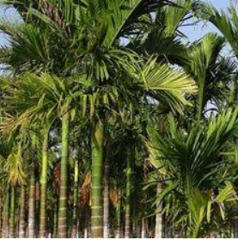
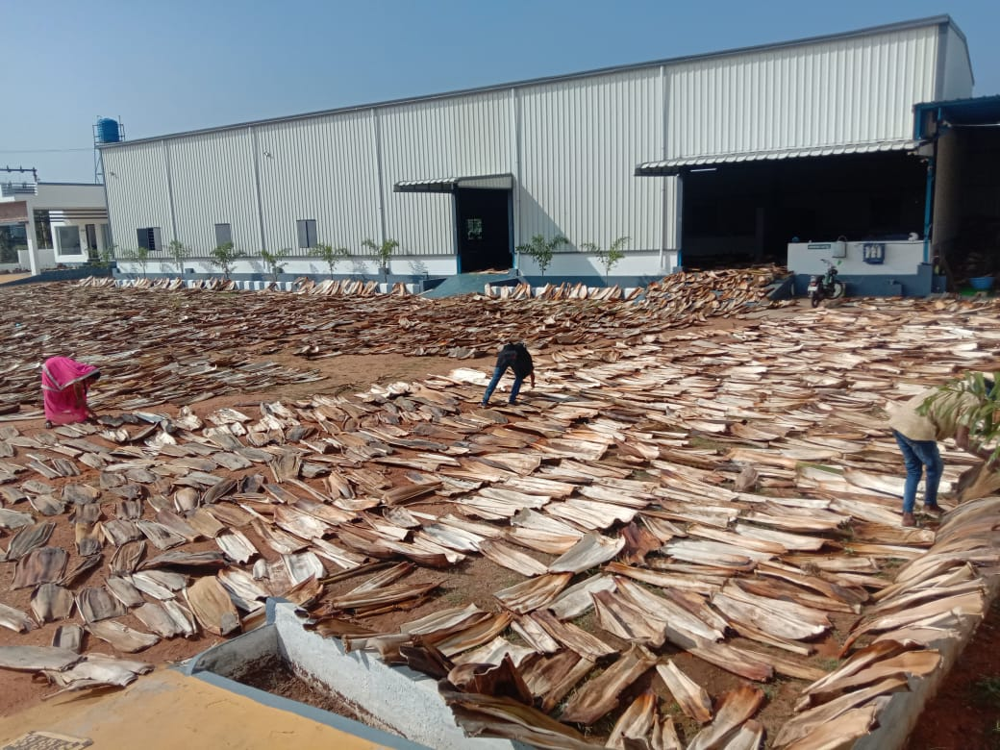
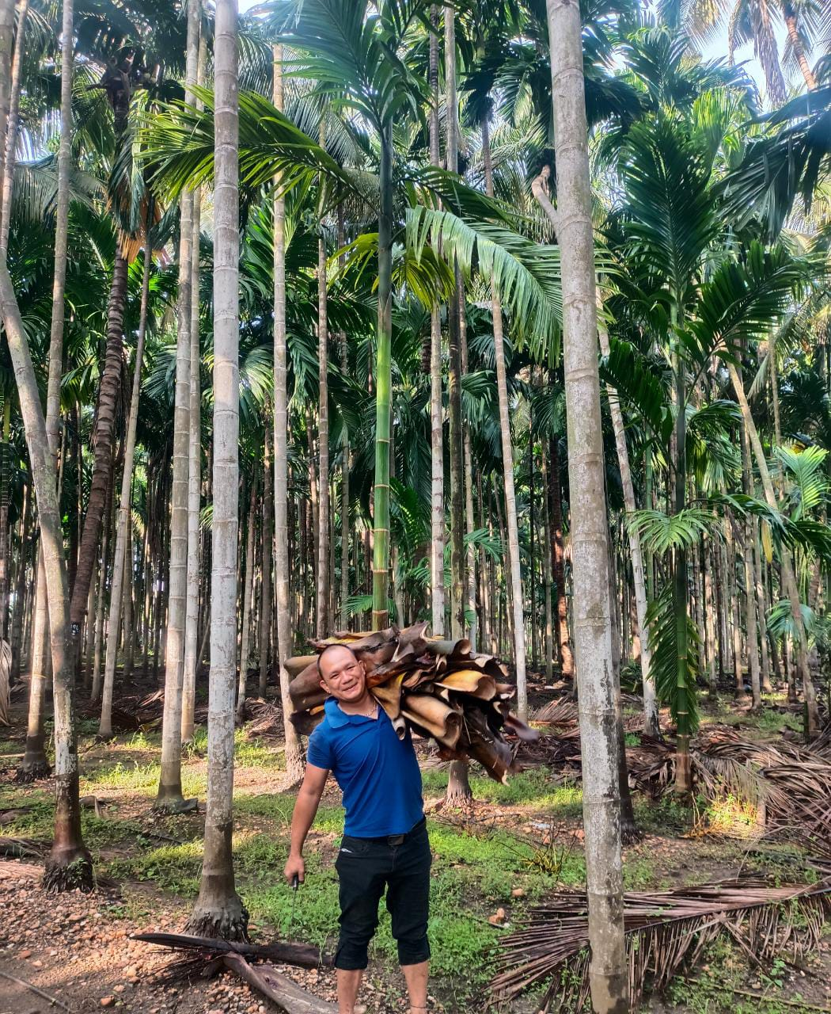
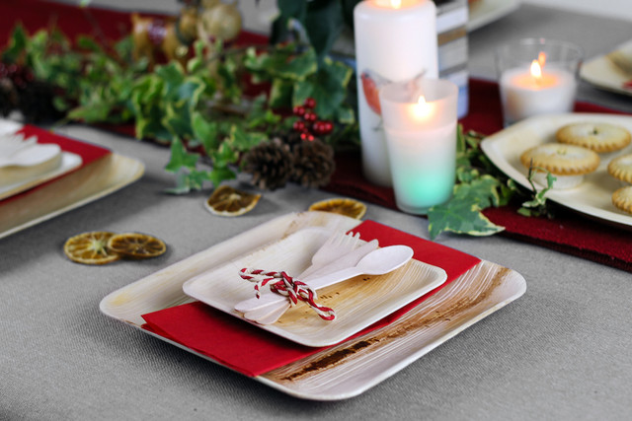
ASTER

Slide 2
ABOUT ASTER
Aster is a manufacturer and visionary brand, the global specialist in plant-based compostable foodservice product.
Our extensive range of eco catering disposables offers quality environmentally-friendly products at competitive prices.
Our hot and cold Plates are made from renewable, lower carbon or recycled materials, and can all be composted with food waste where accepted
We strongly believe environmentally friendly, elegant, and affordable, disposable palm leaf plates are the best solution to keep our environment healthy
We are in the business of Eco Friendly Products in the industry for the past 10 years.
We have a basic motive of promoting the Eco friendly environment.
In the way of implementing that we are involved in the manufacturing and exporting of nature palm products.
By the way of promoting the bio friendly product usage, we are also employing people from rural areas for a fair wage

Slide 3
ASTER - VISION
Plastic pollution is one of the greatest environmental challenges of current time
Not many people realise that plastic can – apart from desolating the environment – be cancer-causing
Scientists estimate the ocean will be more plastic than fish in 2050
Especially when foods served in plastic containers, some amount of plastic inevitably gets into the food which is directly related to human health
VISION → To create Plastic free food industry with an alternate source which is closer to earth, bio-degradable, compostable, nontoxic, chemical-free, and safer for man, animal and earth
Our products would be 100 percent recyclable, unlike the “compostable plastics” that have 30 percent plastic content

Slide 4
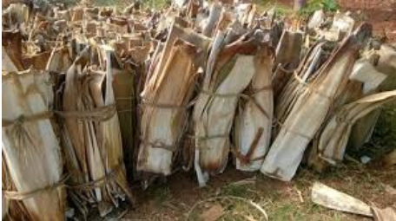
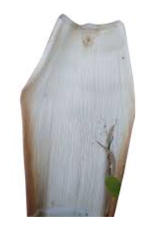
TUMBLED ARECA LEAF - RAW MATERIAL
India has abundant Areca Palm Trees and are cultivated for "Betel Nuts" which is chewed and is used in making Pan.
Each Areca Tree sheds leaves which naturally fall from the trees are collected from the Areca Farms (No trees are cut)
In India 4 Lac Hectares of Areca Crop has been cultivated, near about 5400 Million Areca Leaves are shredded every year
Top Producing Countries of Areca Products

Slide 5
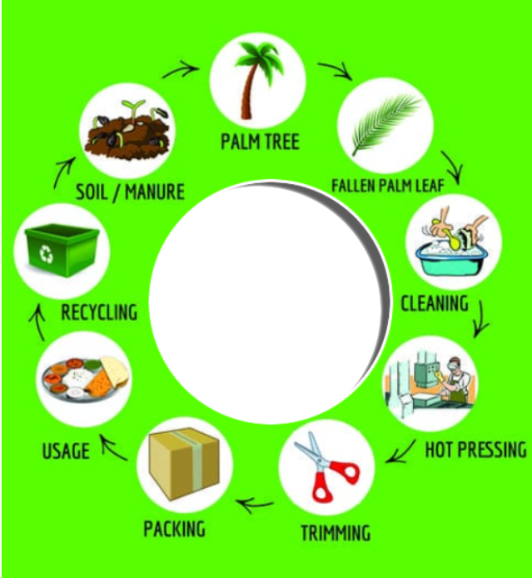
MANUFACTURING PROCESS
As an Areca leaf product manufacturer, we have established our products to be in line with international quality standards
There are no chemicals or flavors used in the entire manufacturing process and 100% chemical free.
Also the entire process leaves very less Carbon Foot Print when compared to other disposable alternates in the market.

Slide 6
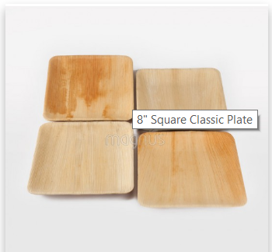
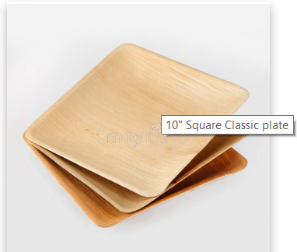
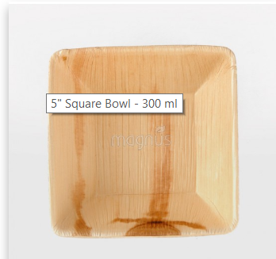
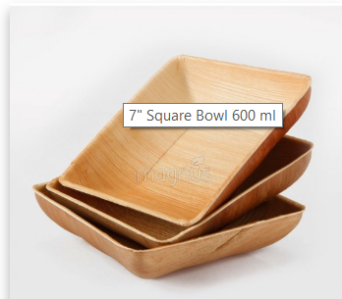
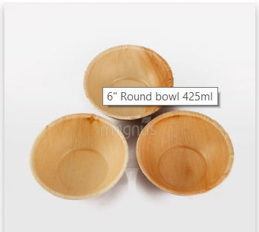
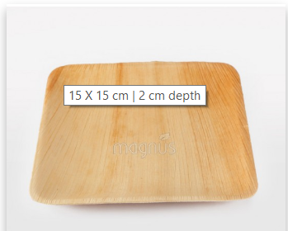
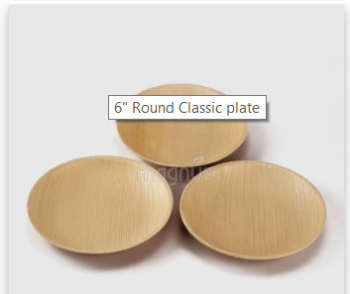
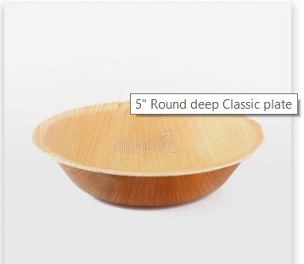
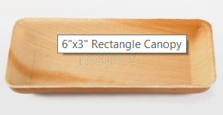
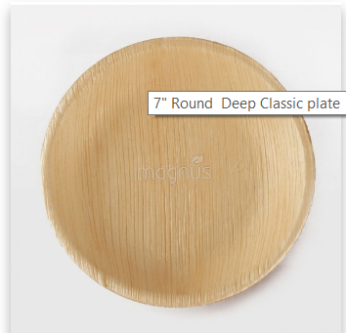
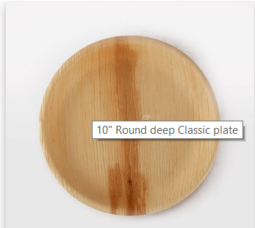
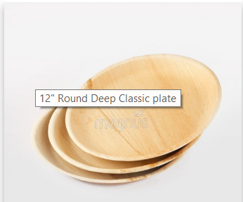
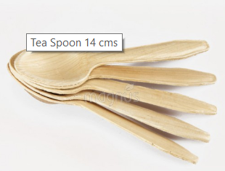
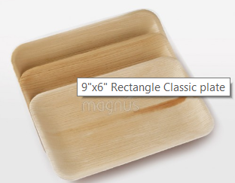
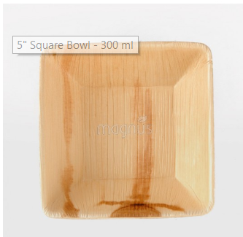
PRODUCTS
Round Plates
Rectangle Plates
Square Plates
Bowls
Cutlery
Note: Above shown are few samples only, this can be customised further basis the requirement.

Slide 7
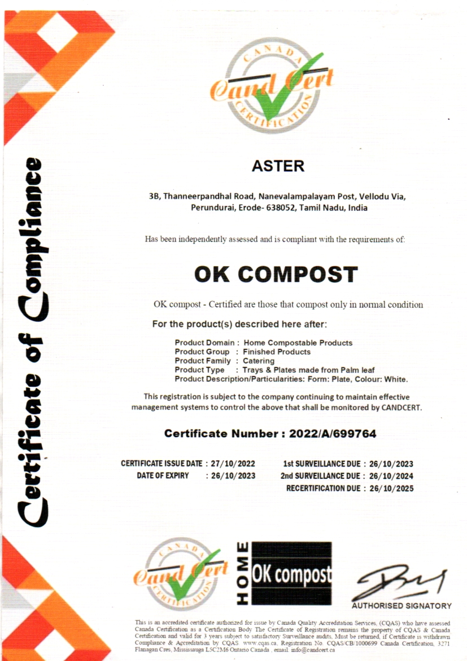
CERTIFICATE

Slide 8
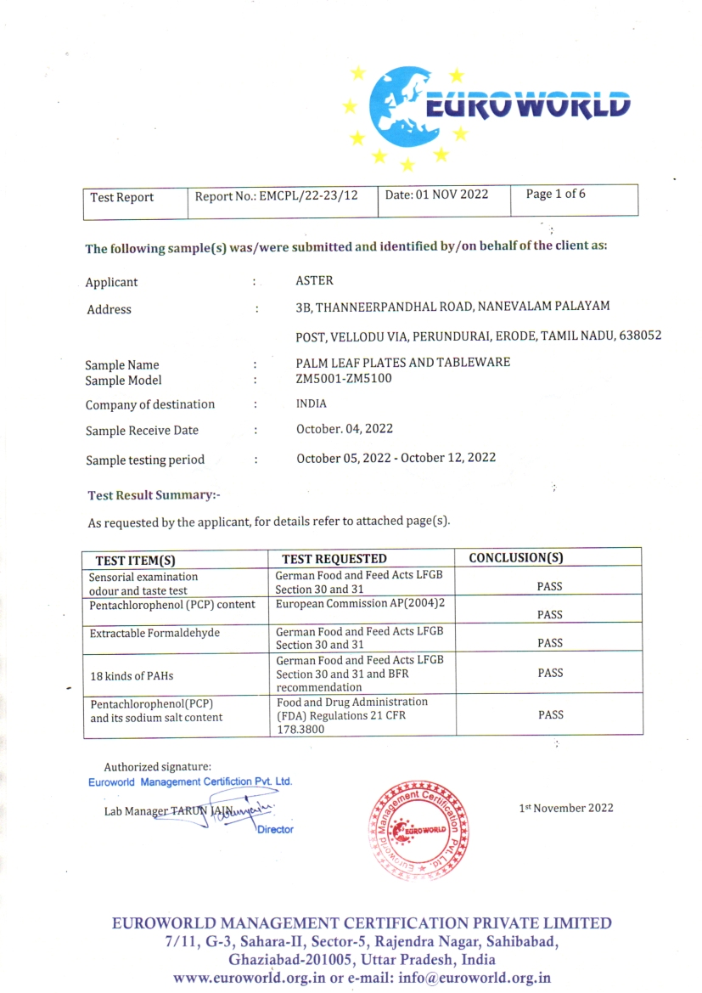
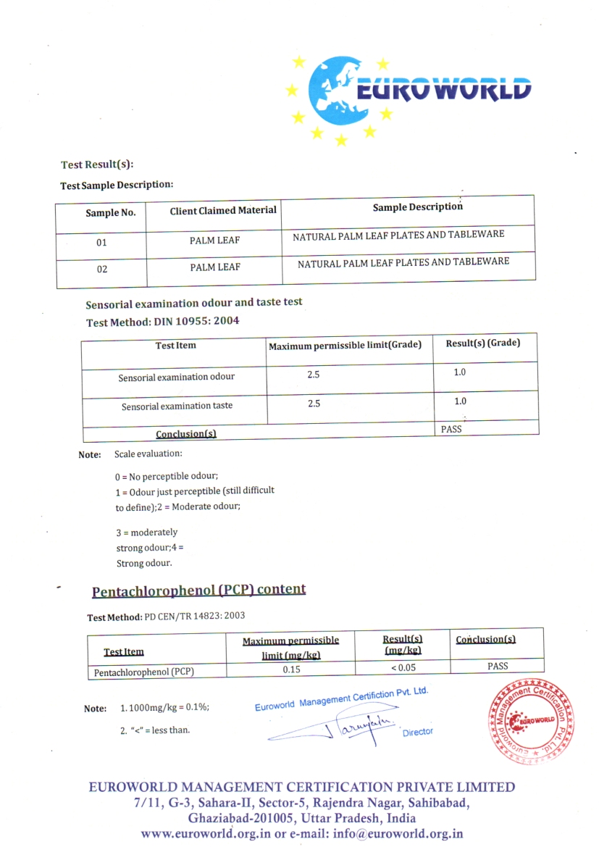
TEST REPORTS

Slide 9
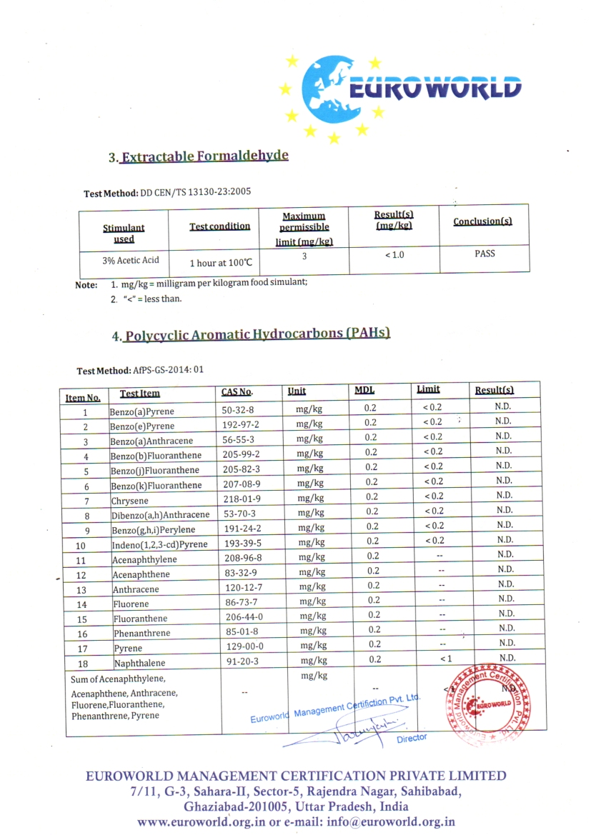
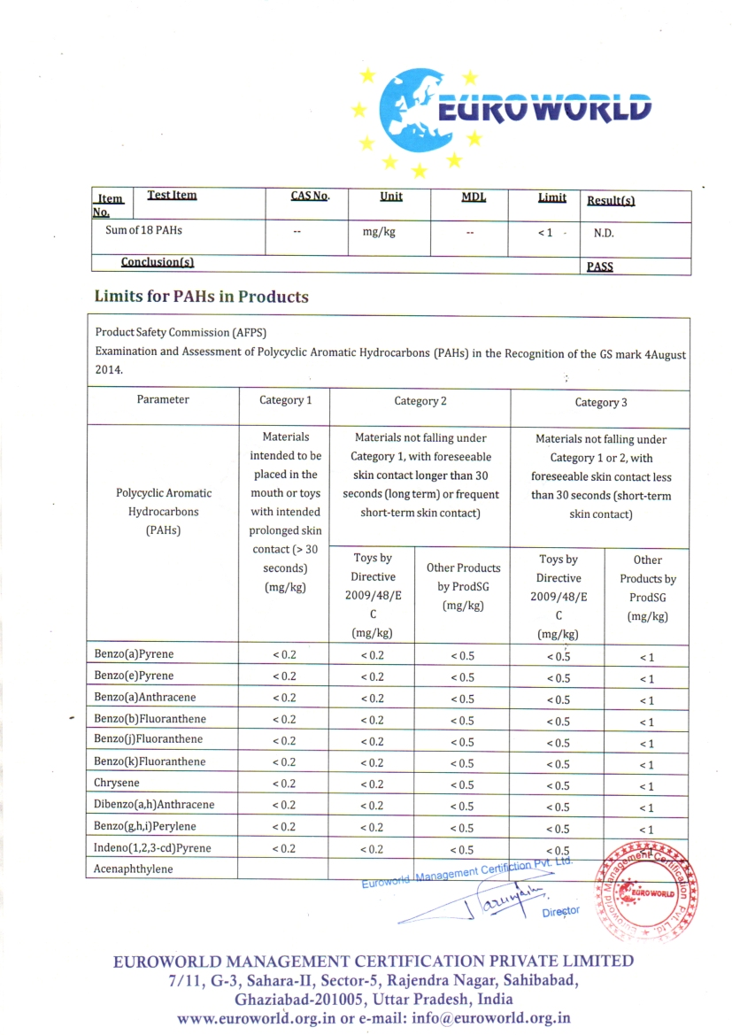
TEST REPORTS

Slide 10
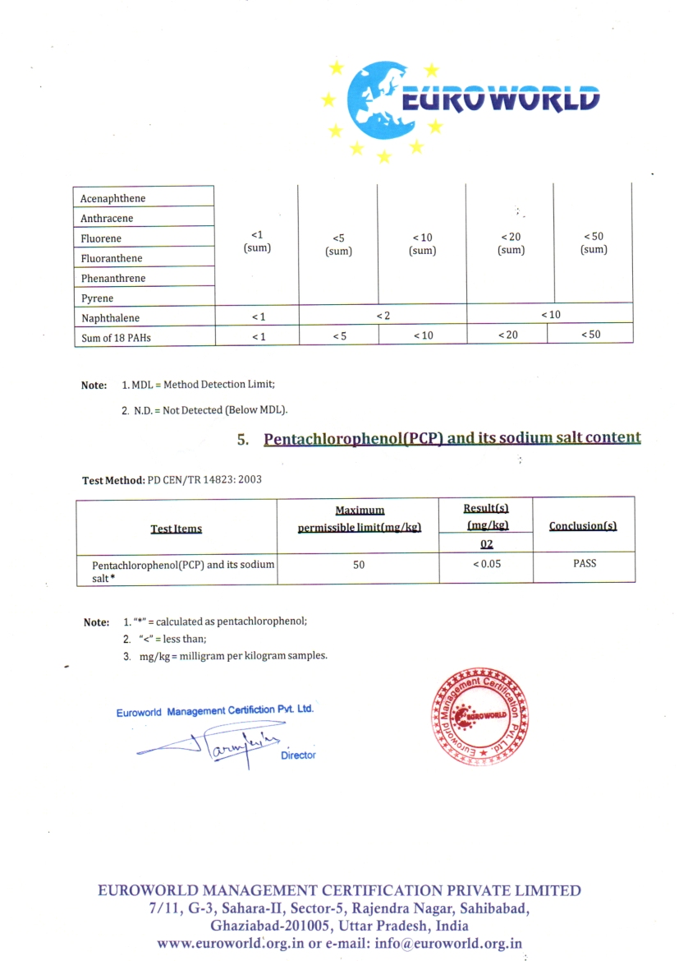
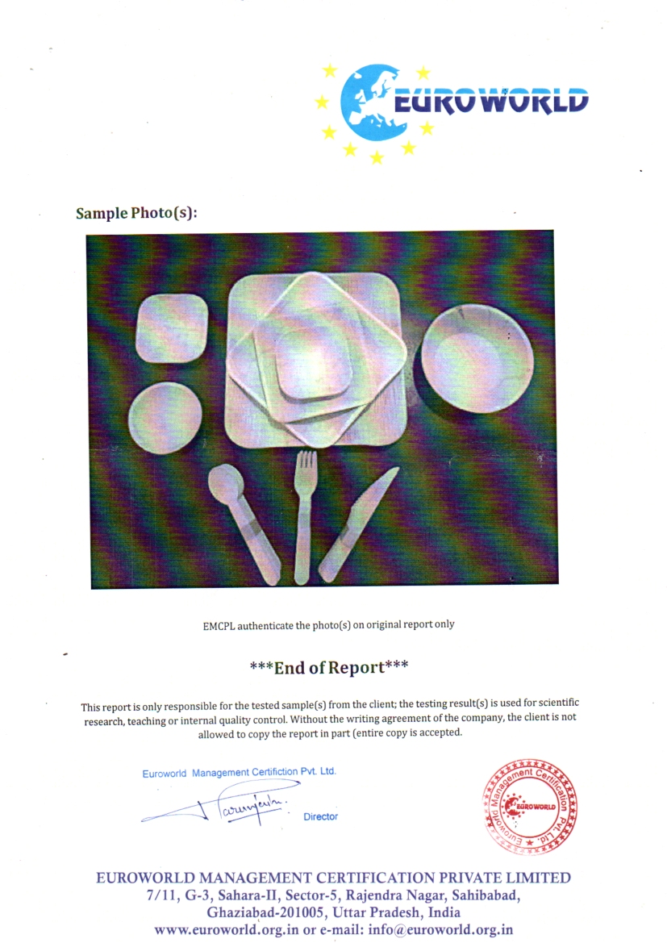
TEST REPORTS

Slide 11
ADVANTAGES OF ARECA PLATES
Our products are 100% Natural, Bio degradable, Compostable and can hold liquids both Hot & Cold
Do not react with food or liquid when used
Waste to wealth concept → Fallen leaves are collected and turned to value added products
No Chemicals, bleaching, PE (Poly Ethylene) coating, Wax coating at any stage
Light weight and being sturdy nature, these palm leaf plates can hold any kind of food with much elegance
Microwave & Refrigerator safe
These naturally shed husks are odorless and water & heat resistant
Hygienic & apt alternative for the plastic and other tableware
Leak Proof
Economical & Commercially Viable
Naturally biodegrade within 6-8 weeks

Slide 12
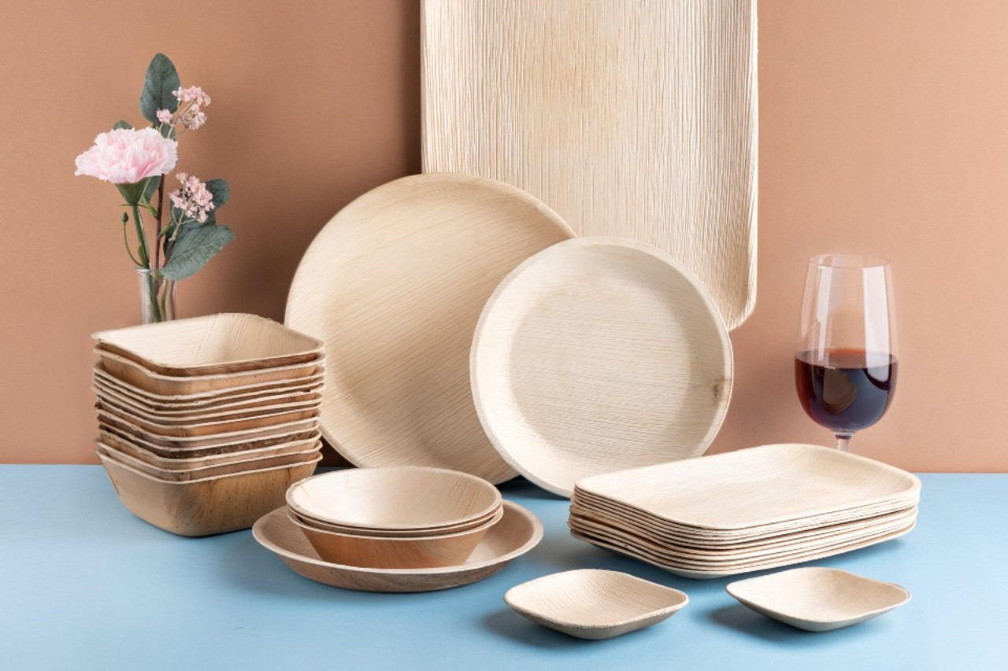
Thank you

